Slide 1
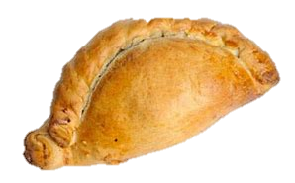
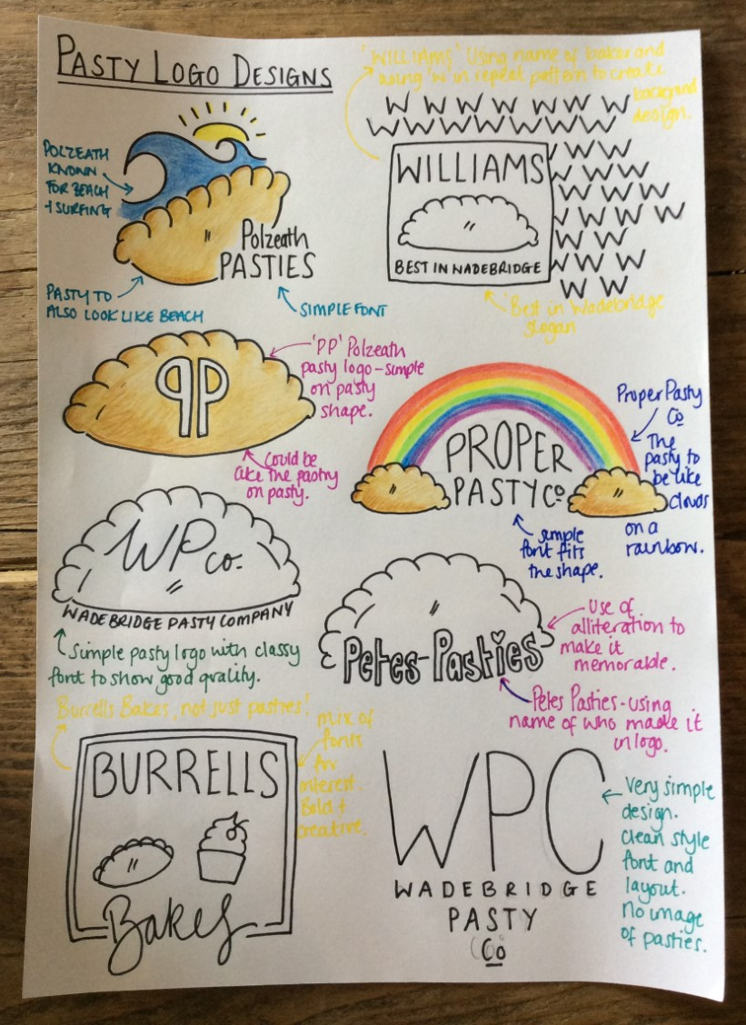
Having created pasties. Your challenge is to create a logo / brand for your pasties to sell in the local area.
Draw out a range of design ideas for your pasty company. Think about different names you could use, and use a combination of imagery and text to create the logo for your pasty company.
Present at least 3 different design ideas on paper, and label / annotate them to show your likes / dislikes and inspiration. Add colour using pencil crayon. (see the example for ideas)
Extension: You could develop your logo digitally using a number of online logo maker apps or create packaging for your pasties containing your logo design.
See example

