Slide 1
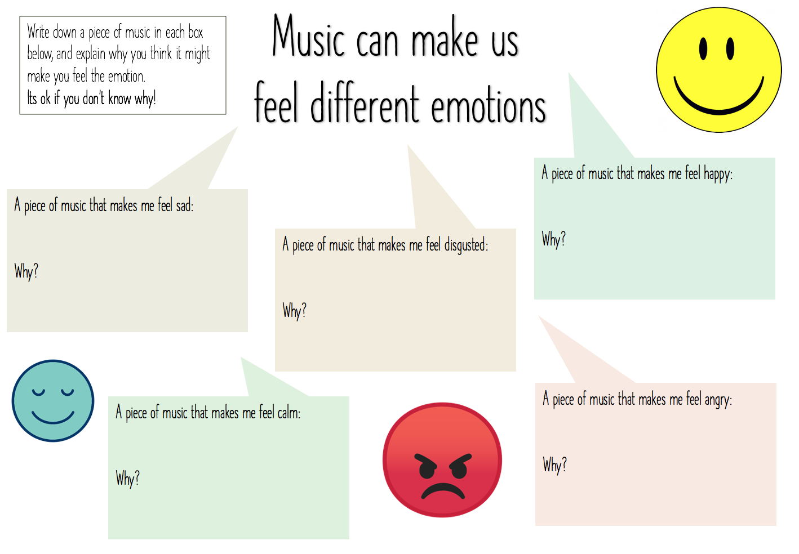

Slide 2
F
Learning to
read music
D
B
G
E
The notes on the lines can be remembered using the mnemonic ‘every green bus drives fast’.
Every
Green
Bus
Drives
Fast
Can you work out what these notes spell out?
1) _ _ _
2) _ _ _
3) _ _ _ _

Slide 3
Learning to
read music
E
C
A
F
The notes in the spaces (between the lines) can be remembered using the word ‘face’.
Can you work out what these notes spell out?
1) _ _ _
2) _ _ _
3) _ _ _ _

