Slide 1
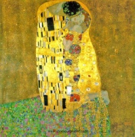
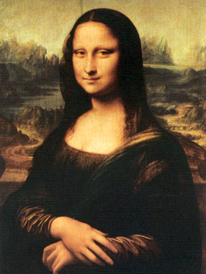
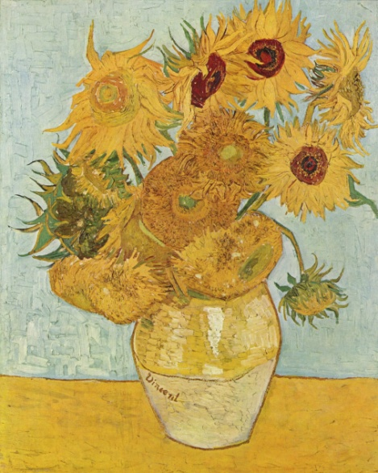
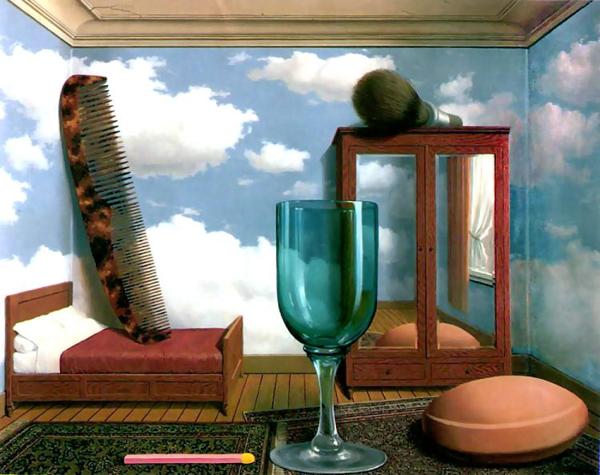
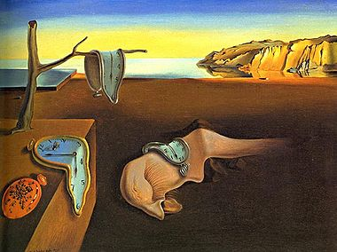
Art and Design Adjective Word searches

Slide 2
The Formal Elements
n | g | t | t | r | e | e | e | t | r
r | r | r | s | i | u | e | r | u | s
e | s | o | e | r | i | o | n | o | s
t | e | x | t | u | r | e | l | i | r
t | s | w | l | t | a | o | l | o | l
a | e | p | w | i | o | t | e | a | c
p | a | n | a | c | i | o | t | a | a
d | h | h | o | c | c | t | t | i | h
s | e | l | r | t | e | i | t | g | d
o | s | h | a | p | e | t | p | e | l
Texture
Pattern
Shape
Line
Tone
Colour

Slide 3
Art Movements
e | m | s | n | e | s | t | t | f | d | s | n | m | r | p
t | h | u | n | m | a | r | f | m | a | l | t | a | r | o
s | u | r | r | e | a | l | i | s | m | u | d | d | t | p
t | o | r | f | p | l | h | e | a | t | a | v | e | o | a
e | t | e | o | u | p | p | e | n | d | o | t | i | p | r
w | r | a | r | e | t | e | h | a | h | r | i | g | s | t
t | e | l | n | r | t | u | l | t | a | e | f | r | o | t
h | a | i | m | o | d | e | r | n | i | s | m | a | r | r
e | u | s | h | a | c | u | b | i | s | m | r | f | h | t
i | a | m | t | o | r | t | n | f | s | n | t | f | r | d
c | i | r | e | t | l | a | b | a | r | m | s | i | l | e
i | m | p | r | e | s | s | i | o | n | i | s | t | e | f
l | a | t | y | t | t | n | n | o | o | e | f | i | s | a
o | t | n | h | h | d | n | f | o | d | n | p | t | r | c
l | l | a | r | t | i | n | e | h | e | a | h | n | d | a
Impressionist,
Surrealism,
Modernism,
Futurism,
Graffiti,
Fauvist,
Cubism,
Popart,
Opart,
Dada,

Slide 4
Artists
m | e | a | f | e | e | u | e | t | s | o | w | r | y | t
s | o | h | e | f | a | i | b | t | y | o | a | n | e | t
w | i | n | e | w | c | h | r | s | e | y | r | p | h | s
d | e | e | d | n | t | p | i | t | e | o | h | c | t | t
i | k | n | i | r | p | p | o | r | o | s | o | n | e | h
o | t | v | o | p | i | c | a | s | s | o | l | n | g | s
i | a | h | o | c | s | a | y | e | r | t | o | o | o | n
d | h | r | a | t | n | r | n | t | t | m | g | a | e | e
b | a | n | k | s | y | o | c | e | e | g | e | o | t | s
o | h | a | o | d | p | c | t | k | v | f | e | t | e | o
n | a | e | y | i | t | l | n | m | l | g | n | h | h | o
v | i | c | s | i | d | r | a | l | u | i | t | n | s | a
d | a | t | u | t | a | f | r | m | e | t | m | h | v | i
m | i | n | l | c | l | y | t | g | o | o | n | t | w | m
m | u | n | c | h | i | s | t | t | g | n | d | n | b | r
Van Gogh
Monet
Picasso
Banksy
Warhol
Klimt
Munch
Mondrian
OKeefe
Dali
Hirst
Davinci

Slide 5
Media
c | t | g | t | f | p | a | h | p | s
i | r | p | e | n | c | i | l | a | m
t | i | a | i | r | i | t | s | s | p
r | e | n | y | t | n | r | t | t | r
i | t | l | k | o | n | c | p | e | u
o | i | s | o | e | n | i | i | l | r
c | i | l | y | r | c | a | a | a | n
a | s | h | t | n | d | y | p | p | l
i | b | y | e | h | o | o | t | o | h
e | l | c | i | c | p | n | o | r | o
Pencil
Paint
Acrylic
Pastel
Crayon
Ink
Print

Slide 6
Print Making
k | e | a | e | p | p | t | a | y | r
c | o | i | t | t | o | t | a | e | l
u | o | o | c | t | h | t | y | s | i
t | a | i | h | w | y | a | a | a | n
t | k | n | i | h | r | a | e | t | o
e | m | a | n | b | c | e | a | e | o
r | r | o | g | b | h | n | d | u | h
a | u | h | n | a | r | d | e | n | e
a | d | r | n | o | h | o | t | b | a
e | k | e | l | r | f | n | o | e | b
Lino
Ink
Brayer
Cutter
Benchhook
Etching
Mono
Potato

Slide 7
Ceramics
a | h | o | f | s | y | b | y | i | e
s | t | h | m | s | a | i | r | s | r
l | c | t | o | i | l | s | r | k | a
h | n | o | o | l | c | q | u | i | w
n | f | r | r | c | e | u | l | l | e
g | l | a | z | e | a | e | s | n | n
l | e | a | t | h | e | r | h | n | o
f | e | w | n | e | n | t | r | w | t
c | t | e | e | d | a | l | o | e | s
s | t | c | u | h | t | t | e | a | t
Clay
Bisque
Glaze
Terracotta
Stoneware
Kiln
Wheel
Slurry
Score
Leather

Slide 8
Colours
e | b | u | r | n | t | u | m | b | e | r
n | u | t | n | c | o | g | i | d | n | i
i | r | h | e | r | i | h | t | i | o | o
r | n | d | e | i | a | h | o | f | a | p
a | t | e | r | m | r | e | t | o | i | a
m | s | h | g | s | o | k | c | a | l | b
a | i | c | i | o | n | r | t | c | e | a
r | e | e | t | n | b | i | a | r | t | i
t | n | r | l | i | v | m | h | n | g | g
l | n | i | n | t | c | c | a | e | g | c
u | a | t | e | l | o | i | v | g | t | e
Crimson
Ultramarine
Gamboge
BurntSienna
BurntUmber
Black
Violet
Indigo
Orange
Green
Ochre

