Slide 1
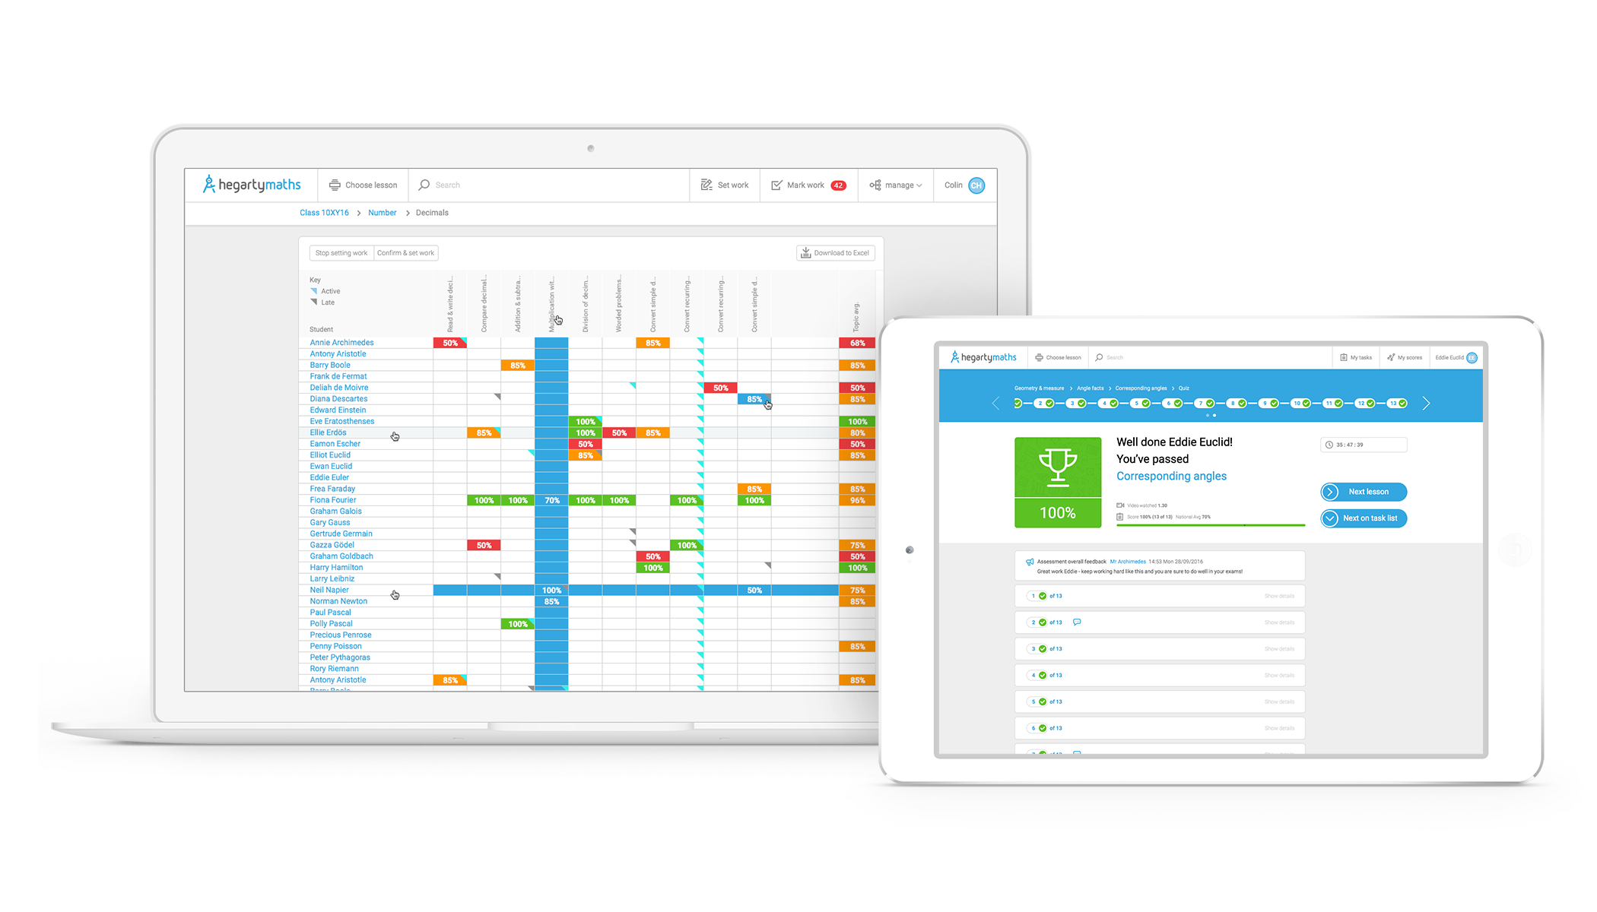
Ensuring your child thrives at home with their maths…

Slide 2
What is HegartyMaths?
HegartyMaths is the best way for your child to learn maths on their own at home.
Every single topic in school maths (850+) is explained in 10 minute video tutorials designed and delivered by, Mr Colin Hegarty. Mr Hegarty is an-award winning teacher who won UK Teacher of the Year 2014 and was nominated in the top 10 teachers in the 2016 Global Teacher Prize. Your child does not have to feel stuck at home as Mr Hegarty can explain any topic to them.
After every video, HegartyMaths, has an assessment with questions covering everything taught in the video so students can practise and ensure they understand the maths Mr Hegarty just presented.
HegartyMaths records everything your child ever does on the system (their progress and effort), reporting it back to the teacher and to the child so it’s clear what their strengths and weaknesses are and how hard they are working.
HegartyMaths allows a parent to see everything their child needs to learn and support them. Often parents who may be unsure of the schools methods like to watch the videos along with their child and understand the techniques their child needs to know.
HegartyMaths, remembers all the child’s mistakes and gives them practice on their weaknesses so they can do impactful independent learning.
The whole curriculum is online for your child to have access to.

Slide 3
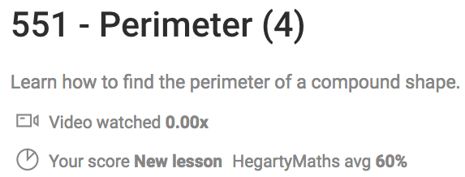
What does work on HegartyMaths look like?
Step 1:
Video where Mr. Hegarty teaches your child everything they need to know about that topic & goes through all the examples that will be in the quiz.
Step 2:
Quiz that will allow your child to practise all the examples in the video for themself and know whether they understood what was in the video.

Slide 4
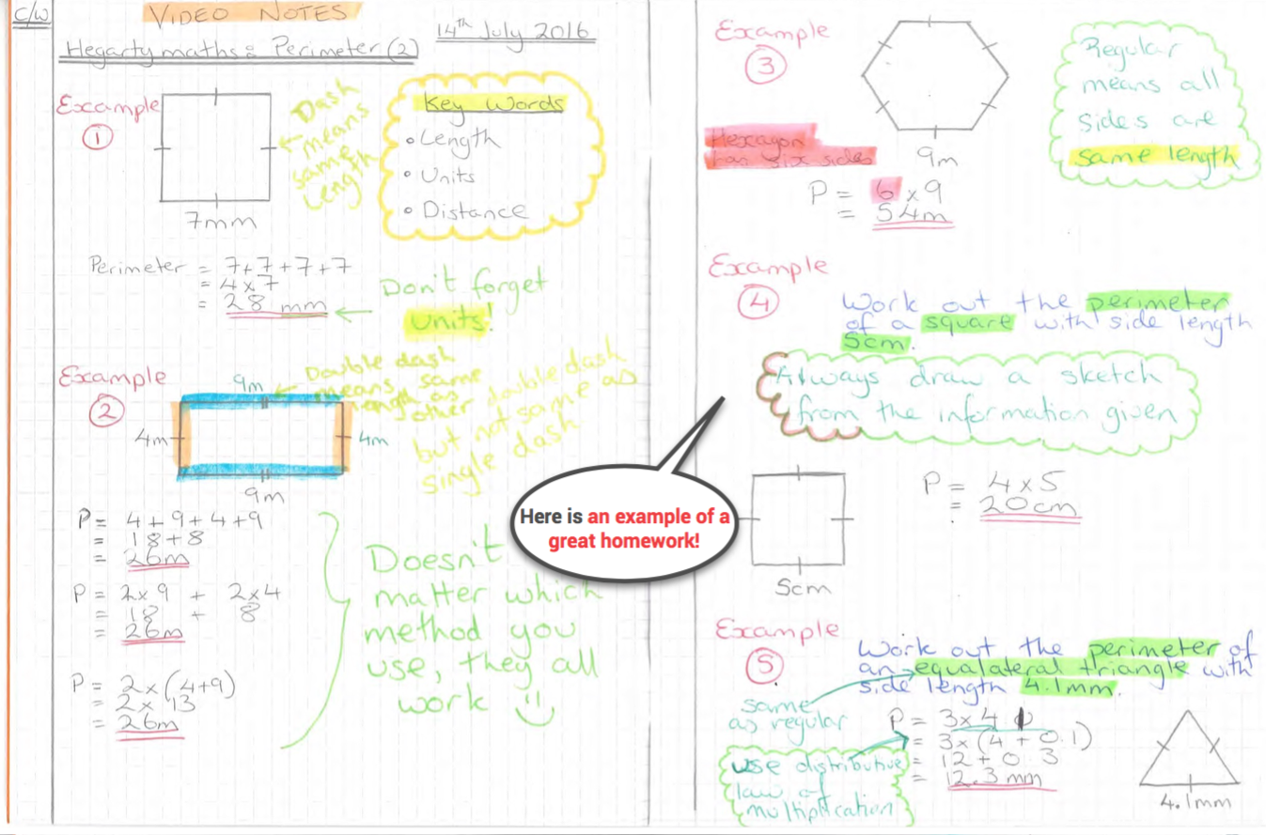
Step 1:
You child needs to watch the video, taking notes of examples.
.

Slide 5
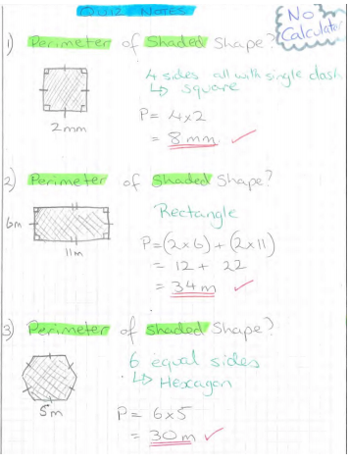
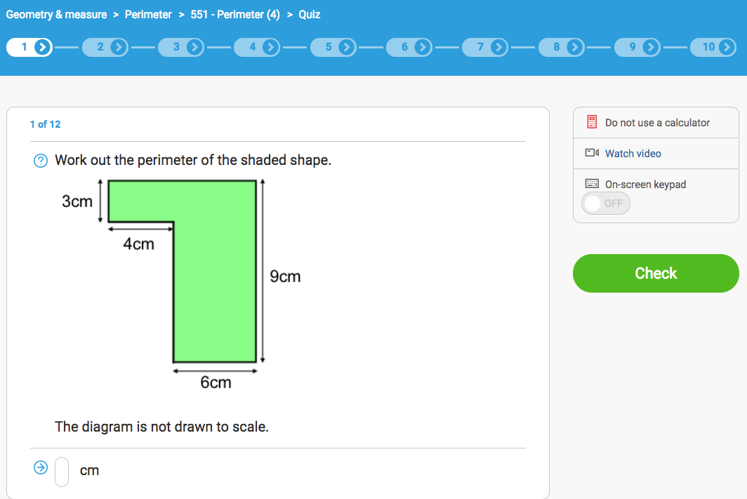
Step 2:
Your child then needs to assess their learning from the video in a quiz.
Ideally Your child needs to:
Write down every Q
Always show all their workings
Always mark and self-correct their work
Your child should always show their workings and mark all questions they ever do. If your child can do the question in their head they still need to show their workings as that is part of being a great mathematician.

Slide 6
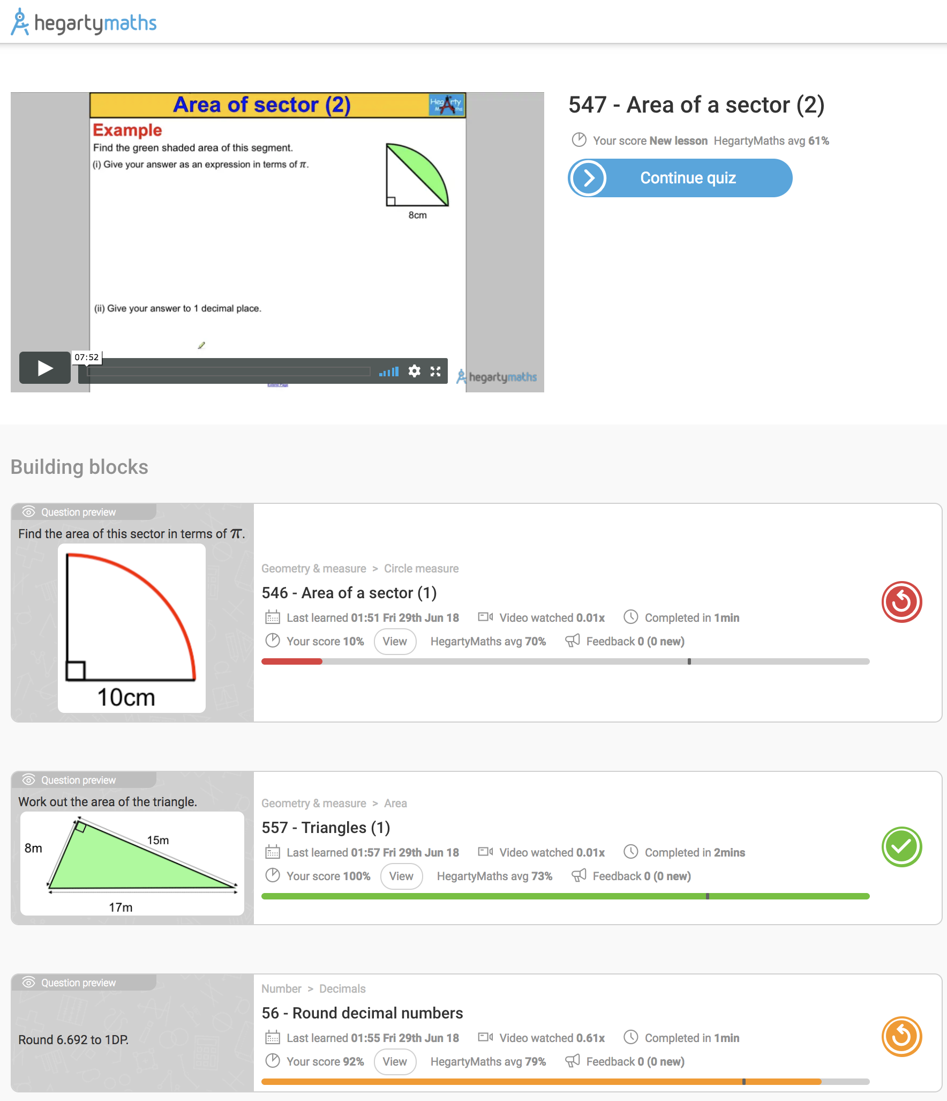
What to do if your child is stuck on their work?
1) Watch the video again really carefully ensuring all examples are copied and see if hearing and writing it down a second time helps.
2) Look at your building blocks. These are the lessons that will help you with your current work. If these are not at 100% or less than the HegartyMaths avg. then you should redo those them as it will help on your current work.
In the picture, the student will struggle with work 547 as they have only 10% on lesson 546.

Slide 7
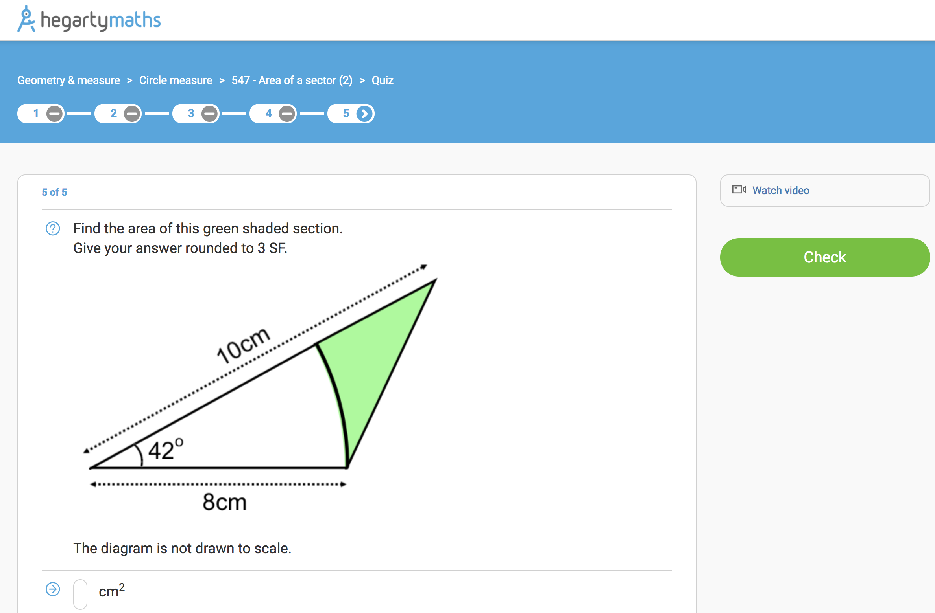
What to do if your child is stuck on their work?

Slide 8
What to do if your child is stuck on their homework?

Slide 9
What to do if your child is stuck on their homework?

Slide 10
What to do if your child is stuck on their homework?
There will always be an example in video that will cover an almost identical question to the one they are stuck on.
They can also pull the video up in the quiz and scrub the video to the place that will help them on the one they’re stuck on.

Slide 11
Why does your child always have to watch the video?
Ensures your child will be successful: Watching the video will ensure your child will do well in the quiz and feel good about their homework and maths. We don’t want your child to feel like they are on their own at home and the videos will give you the support they need to guarantee that they have a successful homework.
Helps improve their memory: Copying down modelled examples helps your child remember their maths and get it into their long term memory.
Method marks: Copying down modelled examples helps your child practise how to lay out their maths properly to help them get questions correct and get extra method marks in exams even when they make mistakes.
Good revision: This is revision. When revising one sometimes has to look over material one already knows – that’s just as important as learning new things as making old learning solid helps prevent students from forgetting things
We thinks it’s important as it helps your child be indepdenent: Doing maths at home with these good habits and methods will help your child become more independent and be able to learn on their own (a vital life lesson).

Slide 12
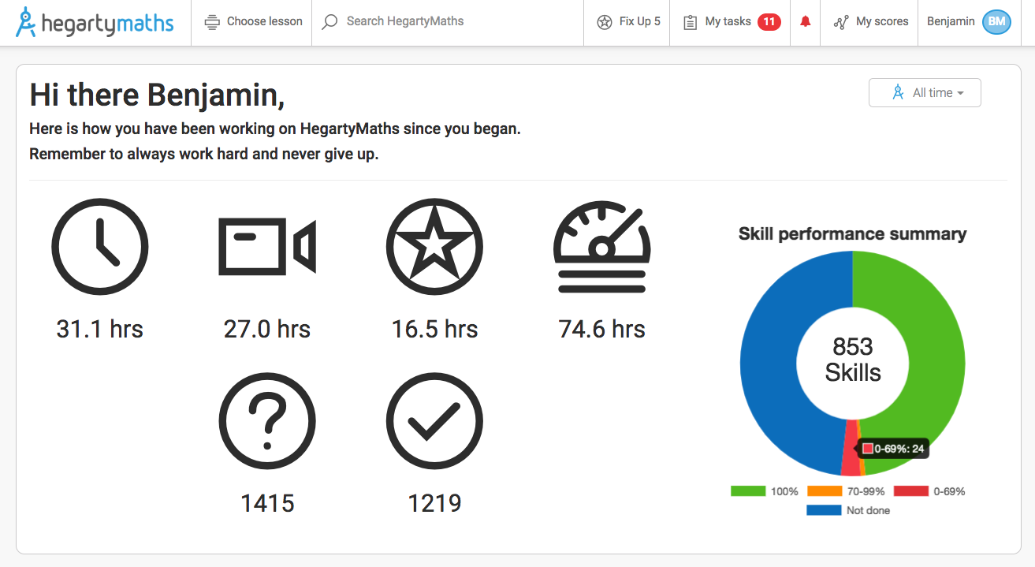
What if your child has completed all work – what else could they do?
1) Use their donut to improve their weak areas: Your child can click the red section to find the quizzes they need to improve (quizzes under 70%) and redo them until they are amber (quizzes over 70%) or green (quizzes at 100%). Once they have made everything green or amber go back over the amber and try to get them to green.
Click the red section and it will open up any lessons your child is under 70% on for them to redo.

Slide 13
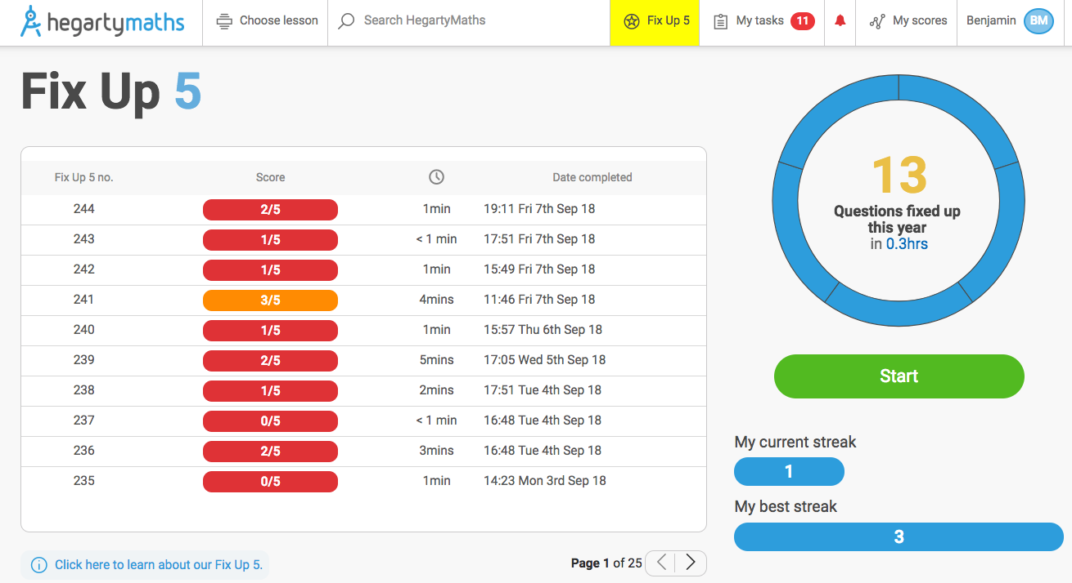
What if your child has completed all work – what else could they do?
2) Fix up 5: HegartyMaths remembers every mistake your child has ever made and generates a quiz with 5 questions from different parts of maths that they are weak on so they can re-do them with the video and Fix Up!

Slide 14
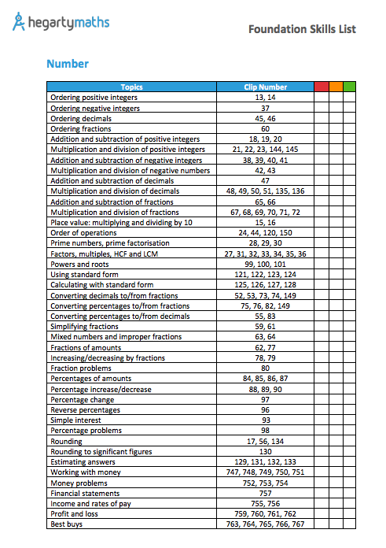
What if your child has completed all work – what else could they do?
3) Learn a new section: Your child’s teacher may have given them a revision list of clips so they can now use that to find a clip on HegartyMaths that will be something that will help get ahead.

Slide 15
What if your child has completed all work – what else could they do?
3) Learn a new section: Your child’s teacher may have given them a revision list of clips so they can now use that to find a clip on HegartyMaths that will be something that will help get ahead.
If your child want to learn Simple interest type clip number 93 into the Search Bar, watch the video and do the quiz in the normal way.

Slide 16
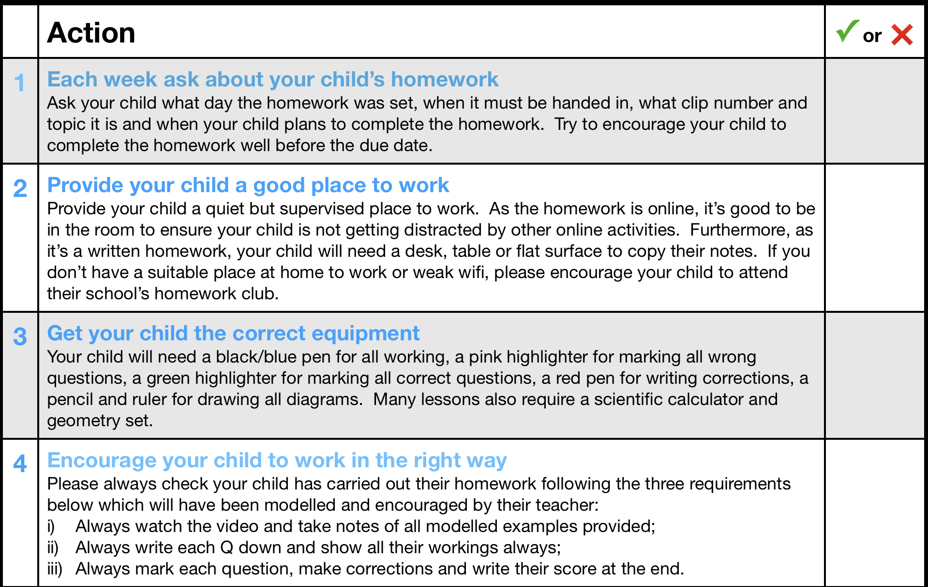
8 things parents/carers could do at home to help their child…

Slide 17
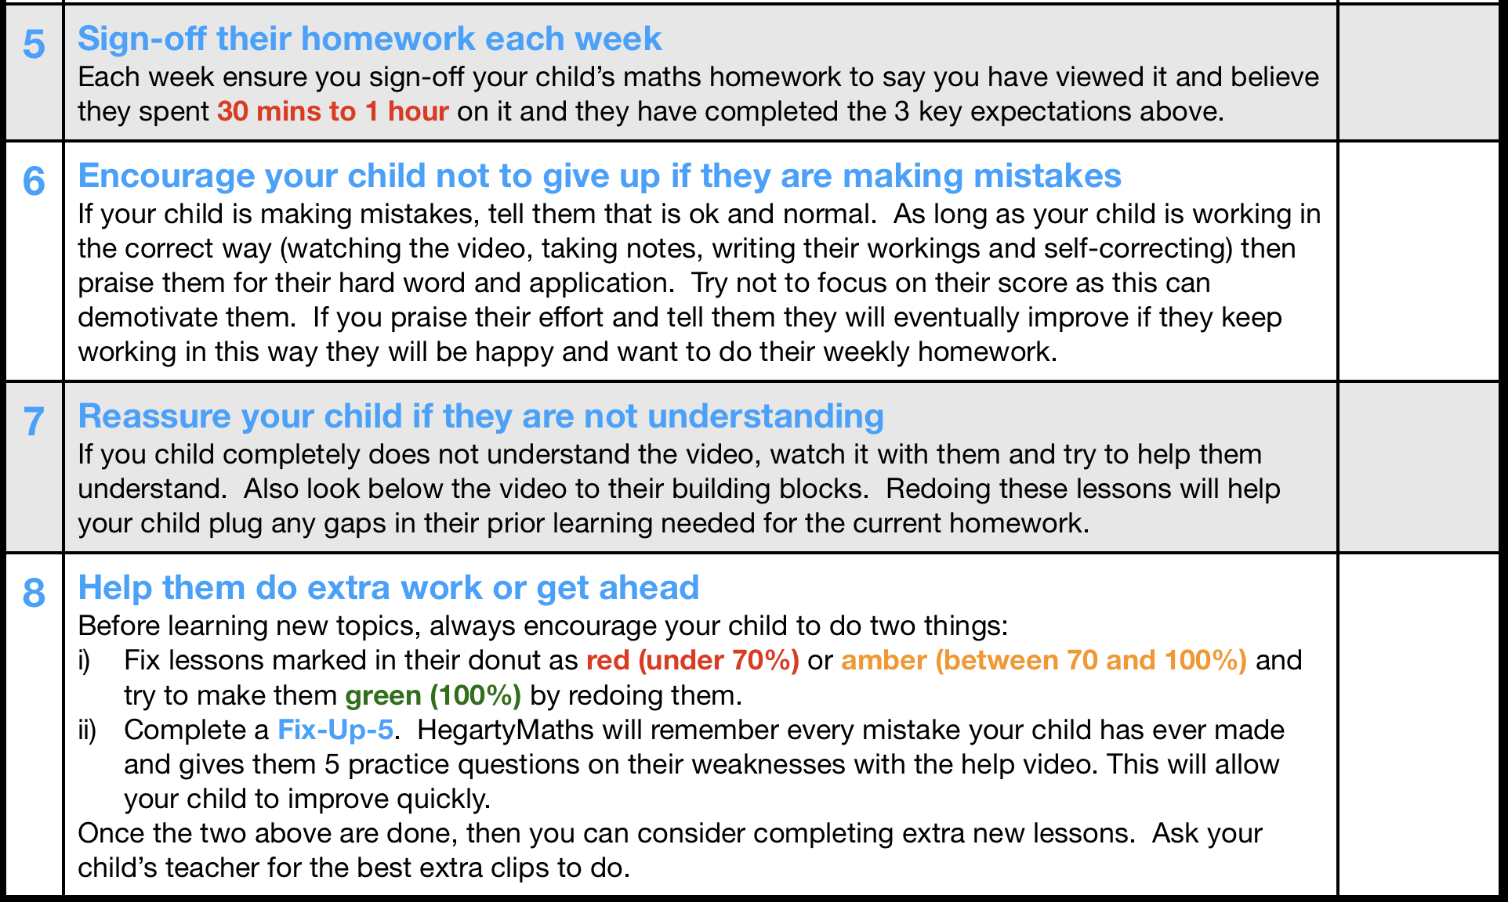
8 things parents/carers could do at home to help their child…

